Slide 1

A deck full of photos
Full-bleed, side-by-side and grid image layouts.
Sample Files by Technology Channel · 1
Notes:
Image-heavy deck.

Slide 2

Full-bleed photo
A 1920 × 1080 JPEG stretched edge to edge.
Sample Files by Technology Channel · 2
Notes:
Full-bleed image.

Slide 3


Photo with text
JPEG remains the workhorse for photographs. It uses lossy compression that throws away detail the eye is unlikely to miss, which keeps files small but means every re-save loses a little quality. PNG is lossless and supports transparency, which makes it the usual choice for screenshots, logos and interface graphics, at the cost of larger files for photographic content.
Sample Files by Technology Channel · 3
Notes:
Image beside text.

Slide 4


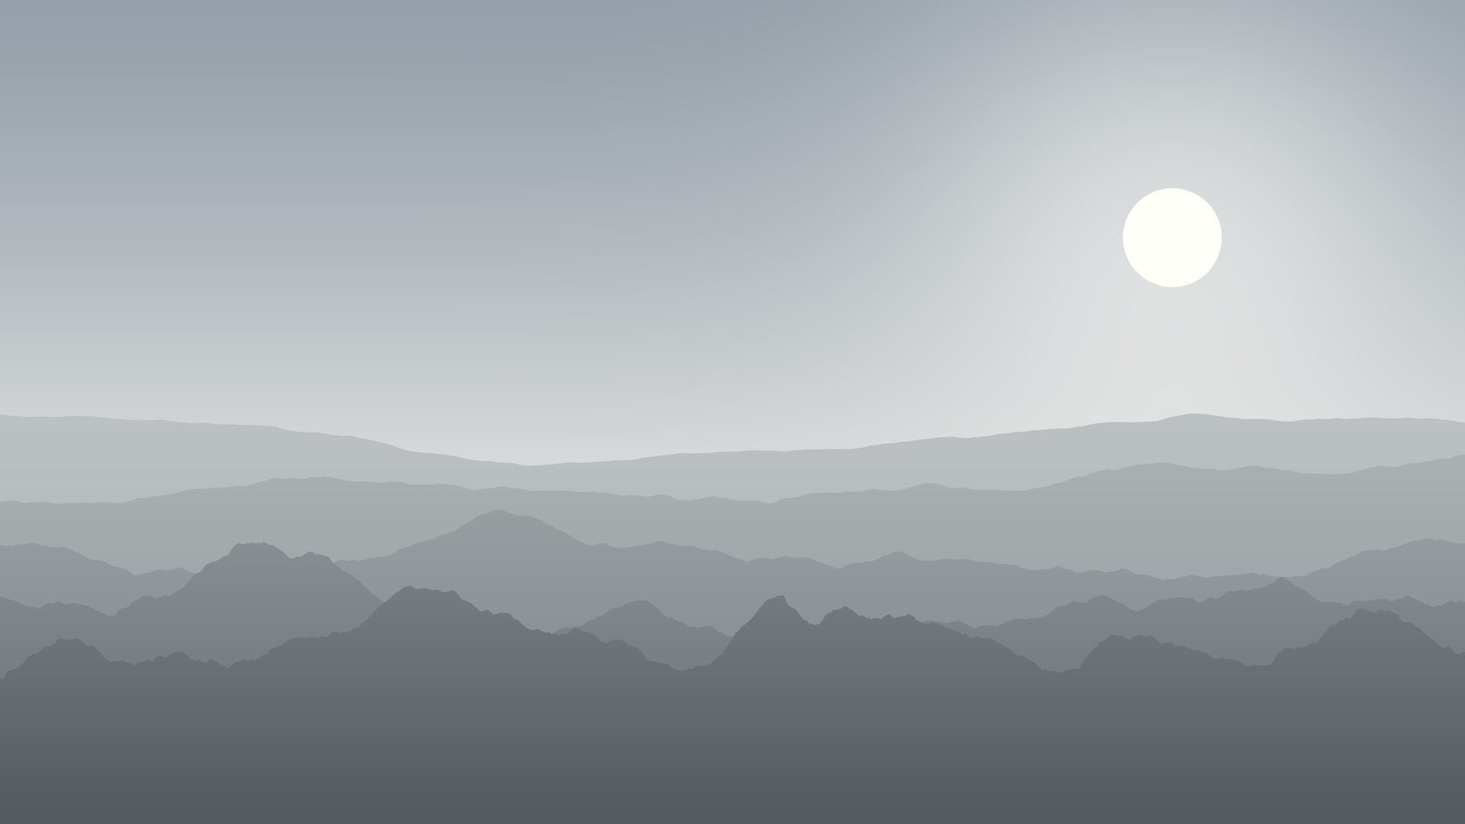
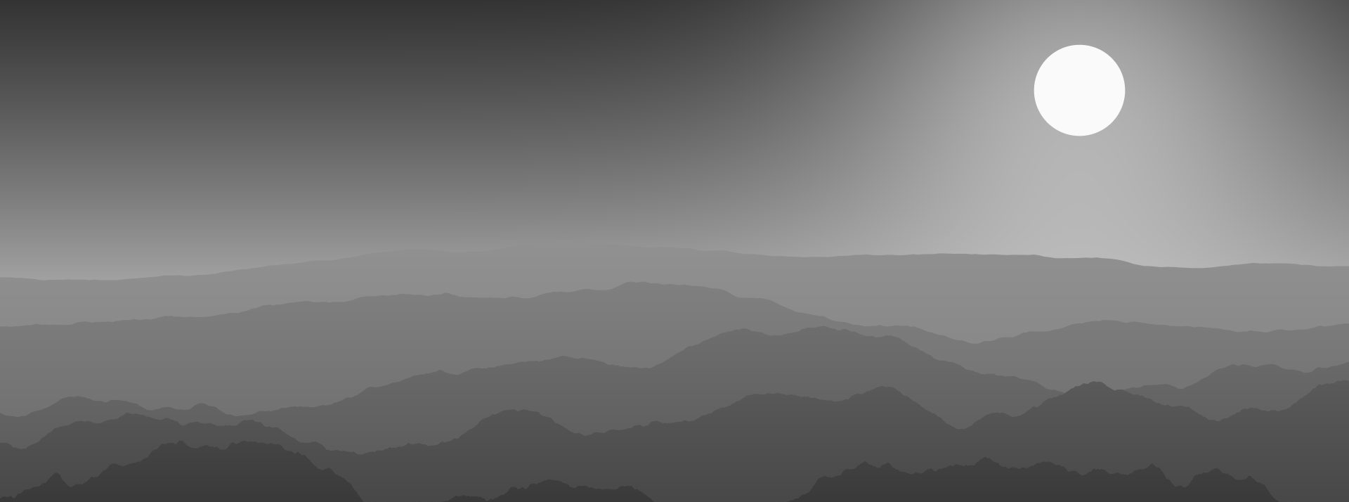
Four-photo grid
Sample Files by Technology Channel · 4
Notes:
Grid of four images.

Slide 5
Another full-bleed photo
Generated landscapes are free of licensing restrictions.
Sample Files by Technology Channel · 5
Notes:
Second full-bleed.

Slide 6
Image and caption
The sample files in this collection include clearly fictional metadata, such as a public landmark instead of a home address, an invented camera and the Technology Channel name as author, so you can test metadata handling without exposing anyone's real information.
Sample Files by Technology Channel · 6
Notes:
Caption slide.

Slide 7
Thank you.
More free sample files from Technology Channel · technologychannel.org
Sample Files by Technology Channel · 7
Notes:
End.

